Slide 1

Weather Temperature and Health Analysis
Subject: Big Data & Cloud Computing
Presented by:
Anusha Thirumalasetti ,
Mohan Chandra Polanati
Date: 2/25/2025

Slide 2

Understanding the Correlation Between Weather and Health
- Weather conditions impact human health in various ways.
- This analysis explores the influence of weather factors such as temperature, humidity, and wind speed on key health parameters.
- The study focuses on heart rate, body temperature, and blood pressure, with data categorized by age, gender, and blood type.

Slide 3
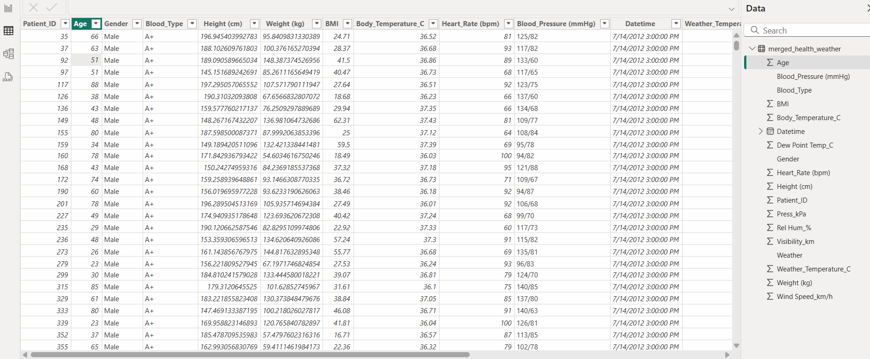
Data Used in the Analysis

Slide 4
Summary of Key Findings
The Weather Temperature & Health Care Analysis project aims to explore the relationship between environmental factors and human health. The study investigates how weather conditions, such as temperature, humidity, wind speed, and dew point, impact key health parameters like heart rate, body temperature, and blood pressure.

Slide 5

Implementation
The implementation chapter describes the process of transforming the raw data into meaningful insights using the selected software tools
Data Cleaning and Preparation: Removing duplicates, handling missing values, and ensuring data consistency.
Dashboard Creation: Building the dashboard pages, integrating charts, and ensuring user interactivity.

Slide 6
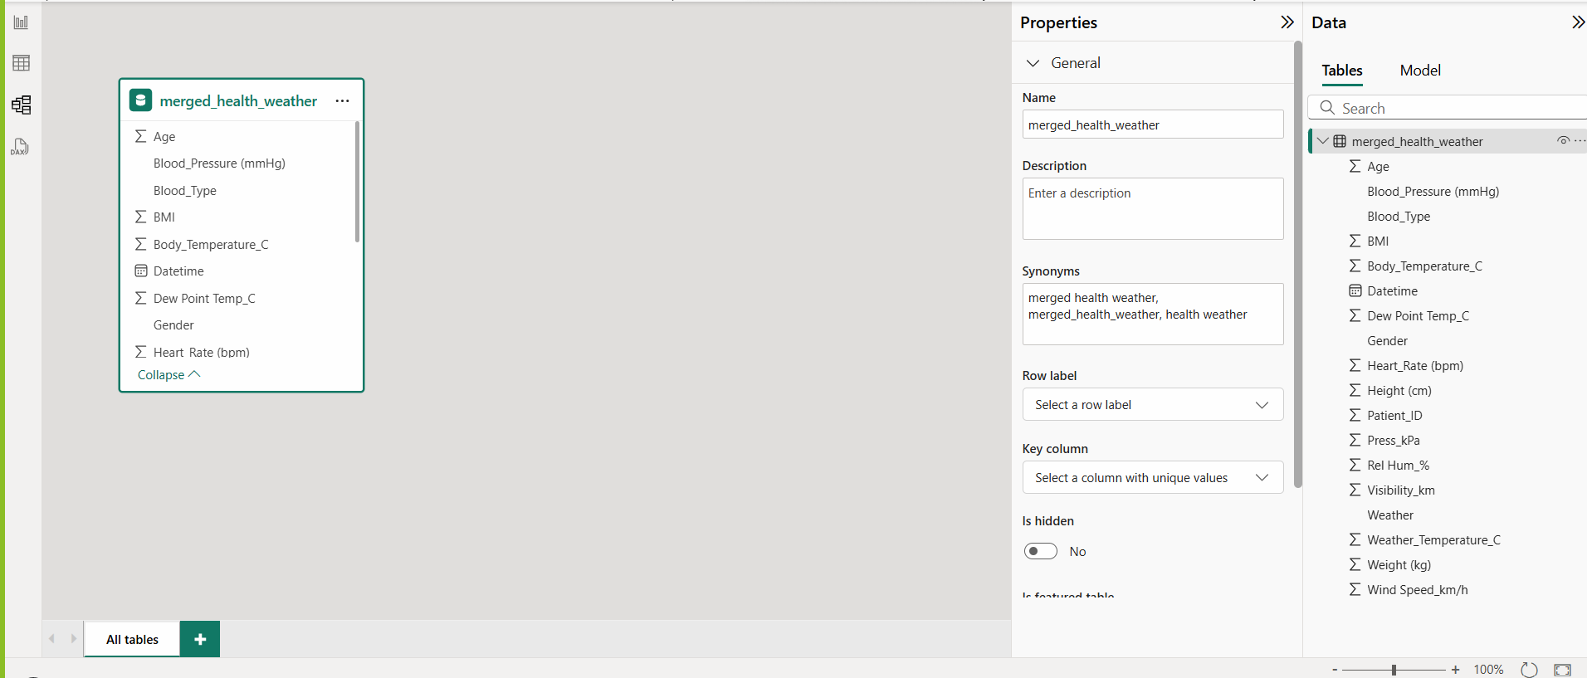
DATA MODEL
The data model for this project is structured to analyze the relationship between weather conditions and human health. The dataset consists of patient health records and weather data, linked through the Date time attribute.

Slide 7
Data Processing Workflow
Data Collection: Patient health data and weather data are recorded based on timestamp alignment.
Data Cleaning: Handling missing values, standardizing units (e.g., Celsius, BPM, kPa).
Data Integration: Merging patient data with weather data using the Datetime key.
Analysis & Visualization: Generating reports on heart rate trends, body temperature variations, and correlations with weather conditions.

Slide 8
Impact of Temperature on Body Vitals
- Body temperature increases with external temperature rise.
- Heat stress can affect cardiovascular health, leading to elevated heart rates.
- Identifying risk groups helps in preventive health measures.

Slide 9
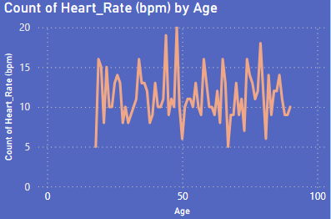
Heart Rate VS Age
This chart shows heart rate fluctuations across different age groups,
with middle-aged individuals (40-60 years)
experiencing the highest variability.
Younger individuals generally have a more stable heart rate, while older adults show moderate fluctuations due to declining
cardiovascular efficiency.
These variations could be influenced by lifestyle,
stress, and external factors like temperature and humidity.

Slide 10
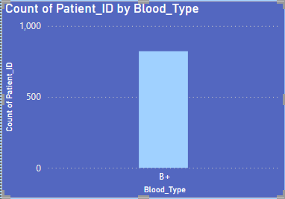
Count by Blood Type
This chart represents the distribution of patients across
different blood types, highlighting which blood group is most prevalent in the dataset.
Analyzing blood type distribution helps in understanding health trends, disease susceptibility, and potential variations in response to environmental factors like temperature and humidity.

Slide 11
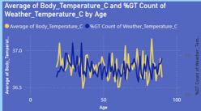
Body Temperature VS Weather temperature by Age
This chart shows the relationship between body temperature and weather temperature across different age groups.
The fluctuations indicate that body temperature varies with weather changes, with some age groups being more sensitive to external temperature shifts.
Understanding this correlation can help in
predicting temperature-related health risks and
improving adaptive healthcare strategies.

Slide 12
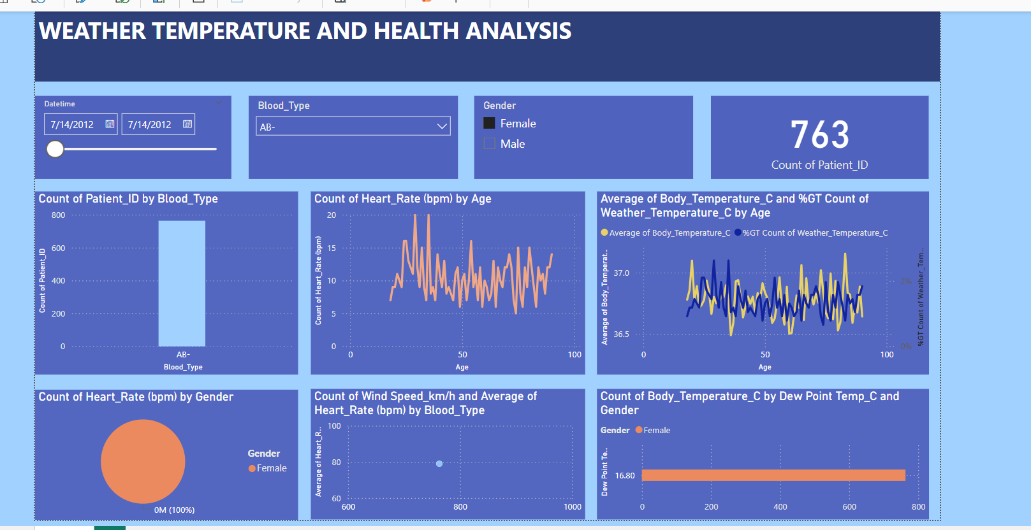

Slide 13

Key Findings & Observations
- Weather conditions influence human health metrics.
- Higher humidity and temperature affect body temperature.
- Heart rate fluctuations are observed under varying wind speeds.
- Certain age groups and blood types show higher sensitivity to environmental changes.

Slide 14
Final Insights and Recommendations
Personalized Health Monitoring: Develop AI-powered wearable devices to track heart rate, body temperature, and blood pressure in response to weather changes.
Climate-Sensitive Healthcare Policies: Establish weather-adaptive guidelines for hospitals and vulnerable populations to reduce temperature-induced health risks.
Public Awareness Campaigns: Promote educational programs on hydration, temperature
regulation, and preventive health measures during extreme weather conditions.
AI & Big Data Integration: Implement machine learning models to predict seasonal health risks based on long-term weather patterns.
IoT-Based Smart Healthcare Solutions: Use real-time environmental monitoring to provide alerts on extreme weather conditions affecting cardiovascular and respiratory health.

Slide 15

CONCLUSION
Weather temperature significantly impacts heart rate and disease susceptibility, with cold increasing blood pressure risks and heat elevating heart rate due to dehydration.
Older adults are more vulnerable to temperature-induced cardiovascular stress, while younger individuals adapt better but still face risks in extreme conditions.
Analyzing weather-health patterns helps in early detection of health risks and improves preventive care strategies.
Future applications include AI-driven predictive models for real-time health monitoring and personalized healthcare recommendations.

Slide 16

.

